Slide 1
International entrepreneurship
Jacques Bazen
Saxion University of Applied Sciences

Slide 2
Overview
International Entrepreneurship: Why? Return on Investments and Risk
International Entrepreneurship: Context: Culture, Political, Social differences
Model for country/supplier selection

Slide 3
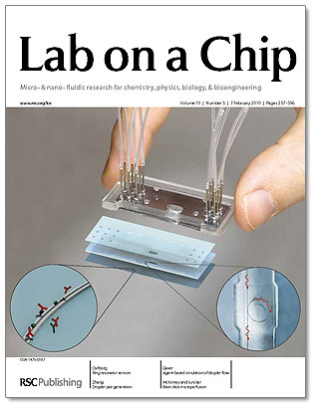
Why to go international?
Some markets are global/international to start with: for example High tech

Slide 4
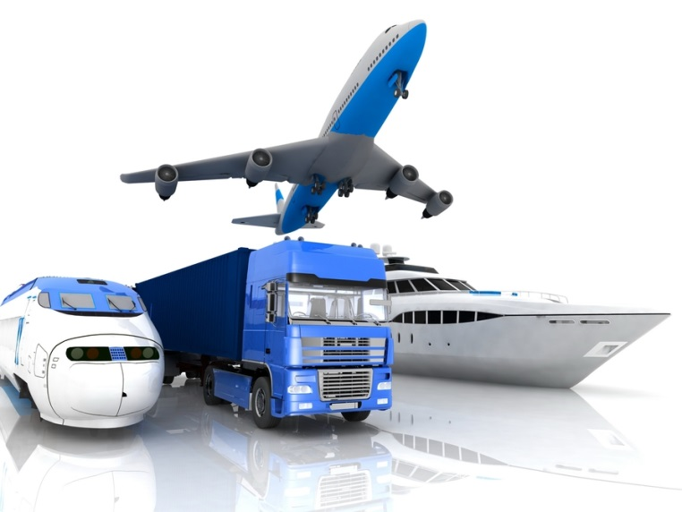
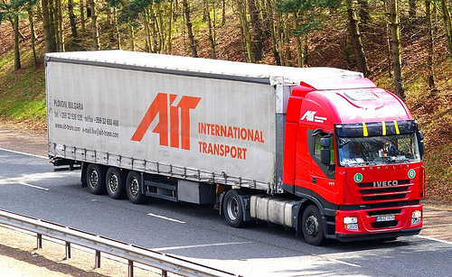
Why go international?
Some markets are international to start with: For example transport sector

Slide 5
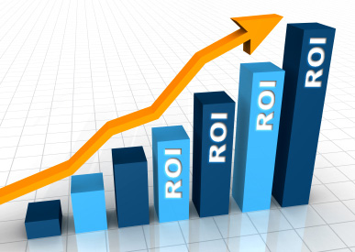
Why go international?
For other markets / products:
Larger return on investments
Barriers for going international:
Increased risk

Slide 6
What activities can be developed international?
For an enterprise, there are many ways to internationalize, for example:
Buying abroad instead of producing (eg. outsourcing)
Selling abroad (eg. trade agent)
Starting a production facility abroad
Making a joint venture / licensing
Etc. Etc.

Slide 7
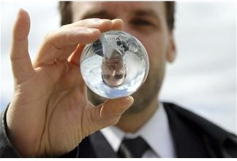
How to make it work?

Slide 8
Barriers for going international
A variety of reasons can withold entrepreneurs from going abroad: - Economic reasons (investment required, doubts about demand, etc.) - Political reasons (stability, ease of doing business etc.) - Technological reasons (distance, transport etc.)

Slide 9
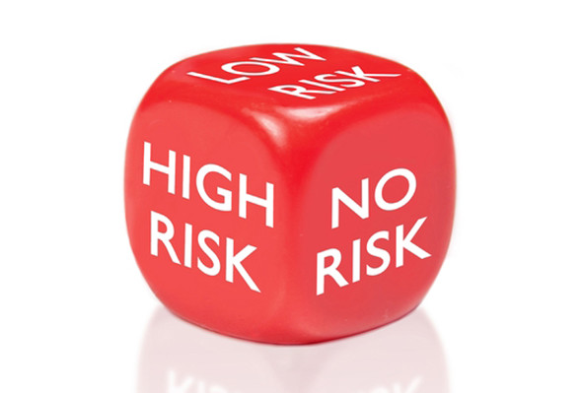
International entrepreneurship
International entrepreneurship is about finding the best international opportunities with the lowest risk involved.

Slide 10
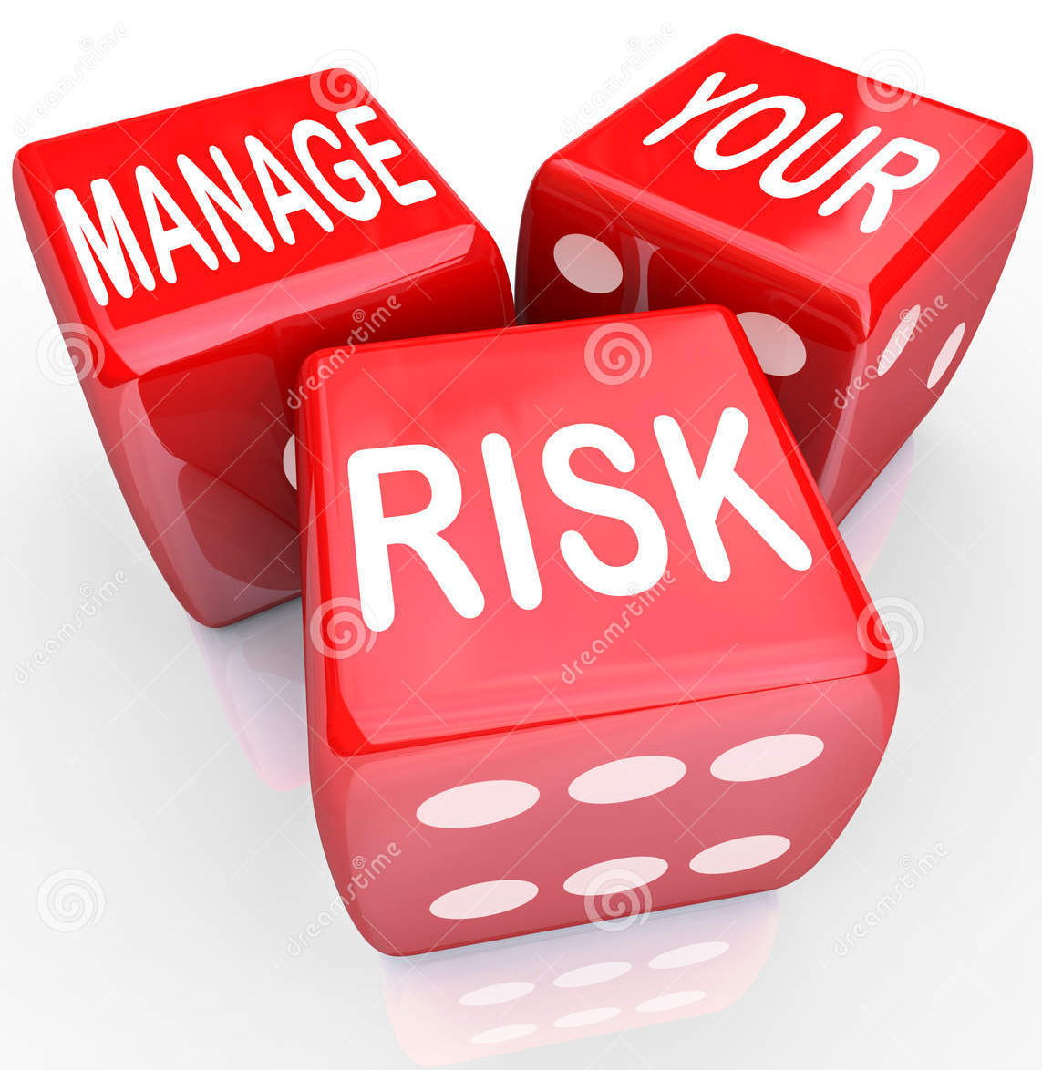
In other words:

Slide 11
Quote from an entrepreneur
“Very nice all that theoretical talk about going abroad, but you just have to do it. Point.
You science guys teach the students to analyze everything so much until their ability to just work is dead. The only thing they see is problems. I don’t need that kind of people.”
Is there a contradiction of Guts vs. Analytics?

Slide 12
How to manage risks?
Looking at the context of target countries:
Demographic
Economic
Social-Cultural
Technological
Ecological
Political / Judicial
variables to decide whether investments are really risky or not…

Slide 13
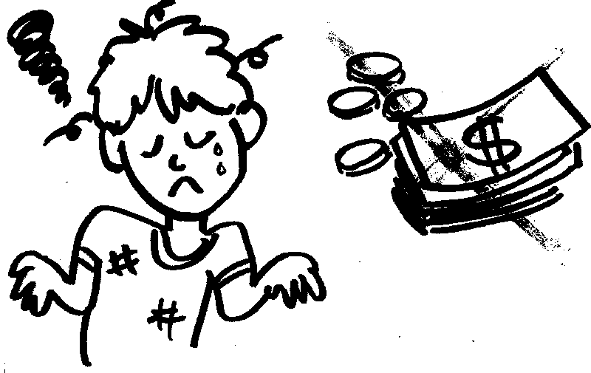
How to manage risks?
In this course so far, we have mainly looked at social and cultural aspects of doing business abroad.
But of course there is more to it than that!
Pitfall: the bad image of a country or region!

Slide 14
Finding out about the context: the business culture
Let’s go briefly through all of the context variables:
Demographic issues: - Availability of workforce (for example brain drain) - Availability of a large enough target market (for example aging population) - Life expectancy

Slide 15
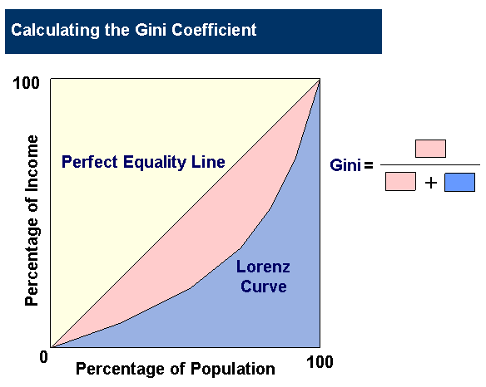
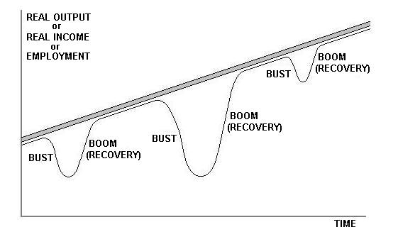
Economic context
Economic issues: - Enough economic means? (GNP) Careful: GNP is an average! - Division of wealth (Gini coeficient) - Economic boom/bust cycles - Price level/exchange rate - Education level

Slide 16
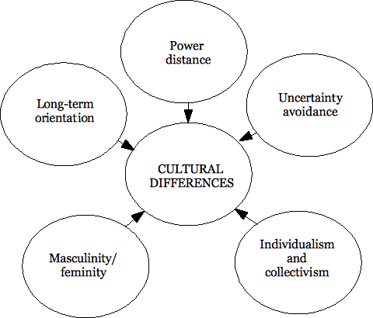
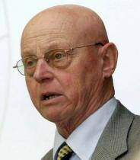
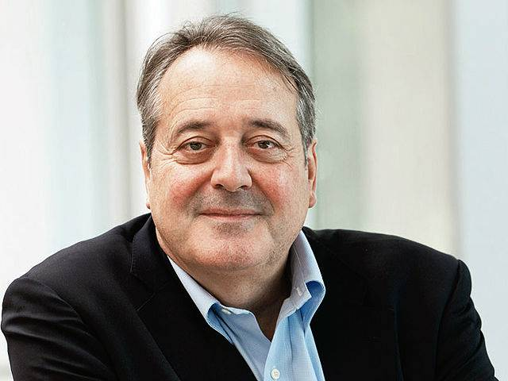
Social-Cultural context
Social-Cultural issues: - Specific socio-cultural issues (for example sale of pork or alcohol in Muslim countries or beef in India) - General socio-cultural issues (how to negotiate and deal with cultural differences)

Slide 17
Socio-cultural context

Slide 18
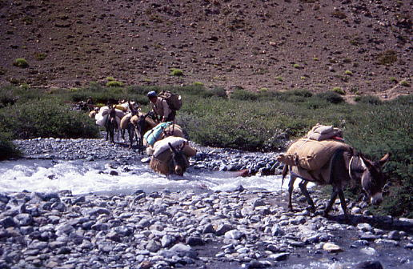
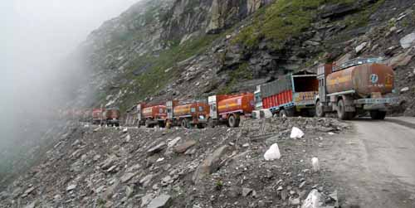
Technological context
Technological issues: These are becoming less and less of a barrier. With better (Internet) infrastructure and transport means it is more and more easy to operate internationally.

Slide 19
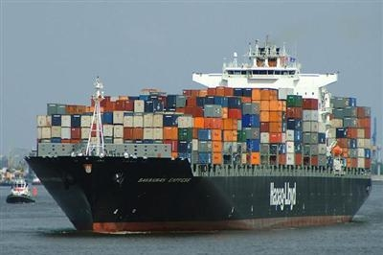
Technological context
The world as global village

Slide 20
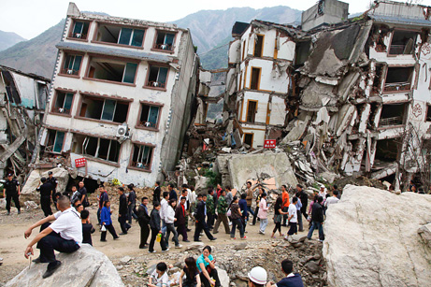
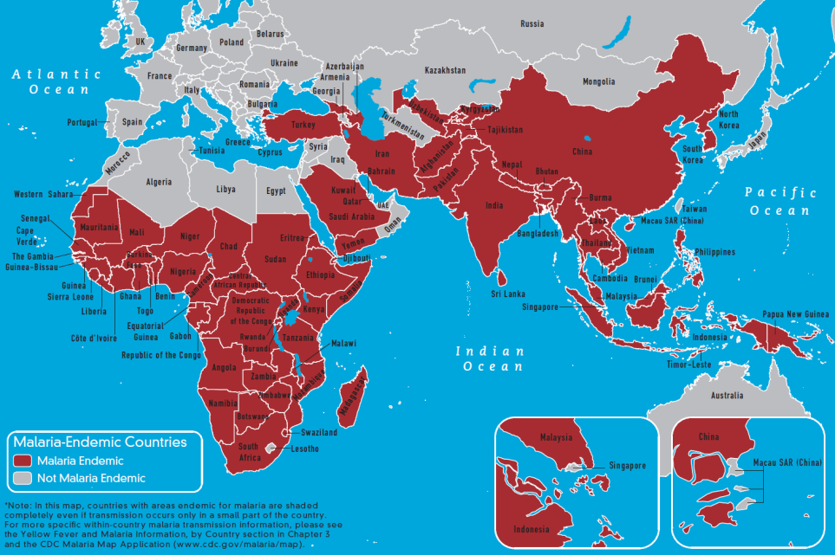
Ecological context
Quality of life & safety issues: - Diseases (for example malaria) - Pollution - Natural hazards (Floods, Earthquakes, Volcanoes etc.)

Slide 21
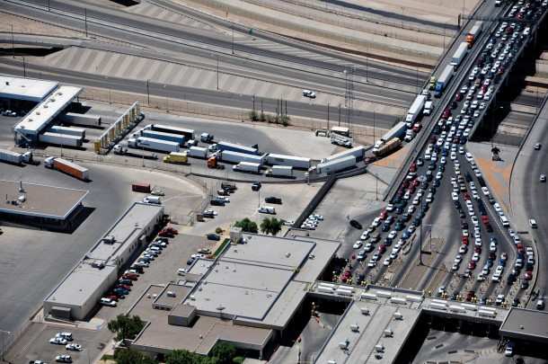
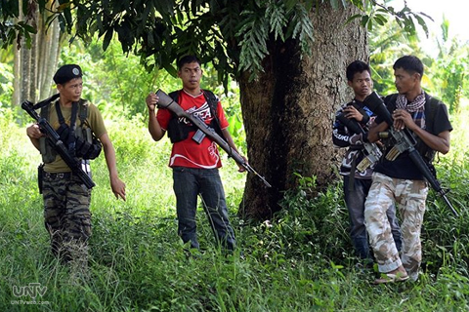
Political / Judicial context
Political / Judicial barriers: - Political stability, trust (risks for “nationalization” or conflicts for example) - Lengthy procedures (customs, bureaucracy) - Import tariffs - Quality requirements (HACCP, CE etc.)

Slide 22
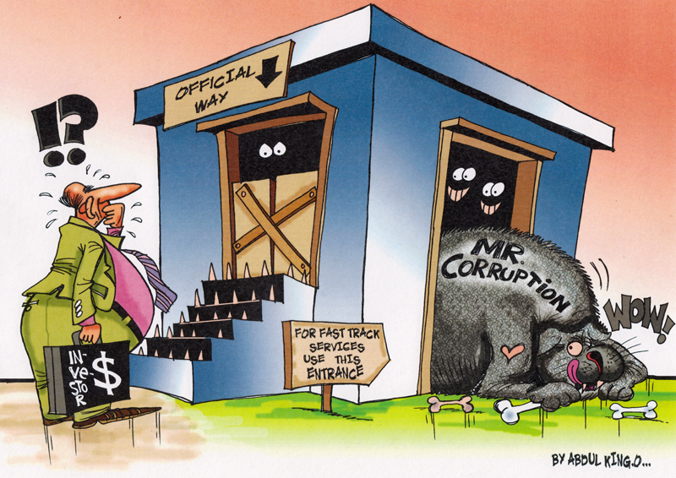
Political / Judicial context
Political / Judicial barriers: - Ease of doing business (for example: http://www.doingbusiness.org/rankings)
Cartoon about investing in Egypt

Slide 23
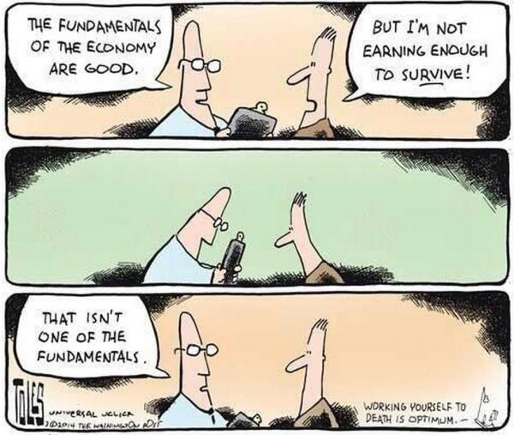
How to get to a plan of approach?

Slide 24
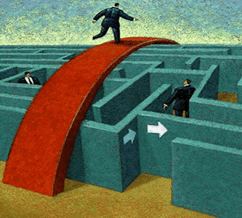
Model for country/supplier selection
How to translate these context variables into an applicable model in business, especially for Start-ups and/or Small and Medium Sized Businesses with limited means?
Filter “funnel” selection model
Pre-selection
Macro filter
Sector filter/company selection

Slide 25
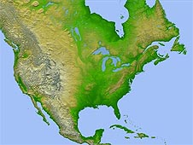
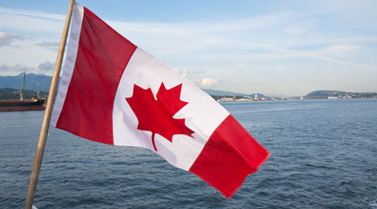
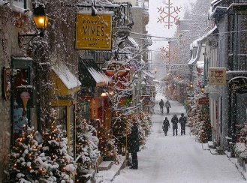
Filter “funnel” selection model
Pre-selection
Country selection
Sector filter / supplier selection
Several filters

Slide 26
Filter “funnel” selection model
Pre-selection
Country selection
Sector filter / company selection
Based on general criteria whether there may be demand for the product or not.
For example: Political stability, GNP and general estimation of the demand for a certain product. Result: Group of potential interesting countries

Slide 27
Filter “funnel” selection model
Country selection
Pre-selection
Sector filter / company selection
Selection of a target country based on the variables
discussed earlier in this presentation, (demographic, economic, social-cultural, technological, ecological, political)
Result: Selection of a country to target activities on

Slide 28
Filter “funnel” selection model
Sector filter / company selection
Pre-selection
Country selection
Based on specific criteria for partner companies to work together with. For example, lead times, prices, quality etc.
Result: Selection of a partner company/supplier/sales agent

Slide 29
Filter “funnel” selection model
Case: Production location Rose hatchery
 |  | Netherlands |  | Spain |  | Kenya
Geography (access) | 3 |  | 3 |  | 3 |  |  | 4 | Most important
Climate | 4 |  | 4 |  | 4 |  |  | 3 | Important
Raw Materials | 1 |  | 1 |  | 1 |  |  | 2 | Less important
Labor | 4 |  | 4 |  | 4 |  |  | 1 | Least important
Capital | 1 |  | 1 |  | 1 |  |  |  | Very good
Infrastructure | 3 |  | 3 |  | 3 |  |  |  | Good
Local knowledge | 1 |  | 1 |  | 1 |  |  |  | Average
Distance | 1 |  | 1 |  | 1 |  |  |  | Poor
Customs | 4 |  | 4 |  | 4 |  |  |  | Bad
Government | 3 |  | 3 |  | 3
Economic development | 2 |  | 2 |  | 2

Slide 30
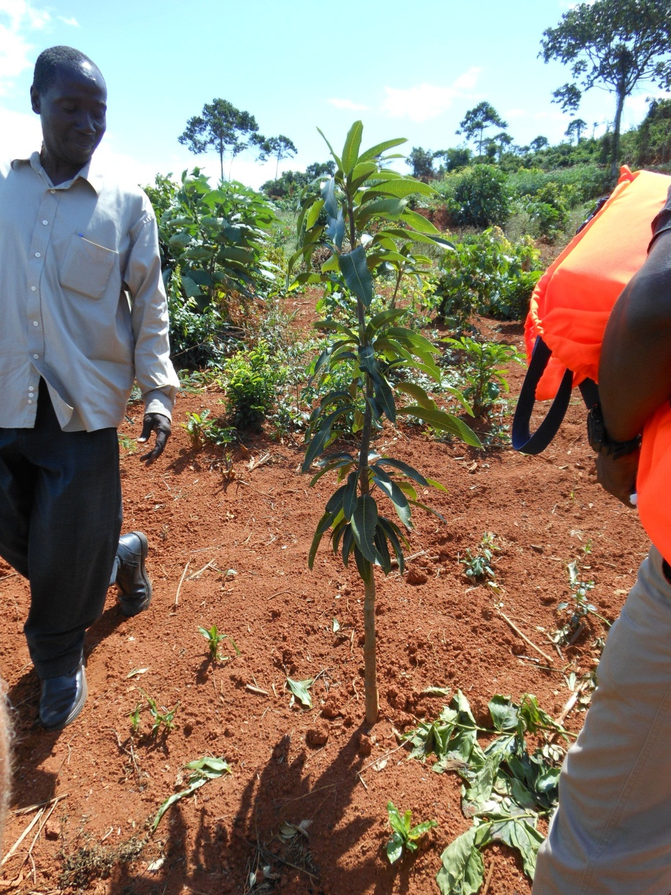
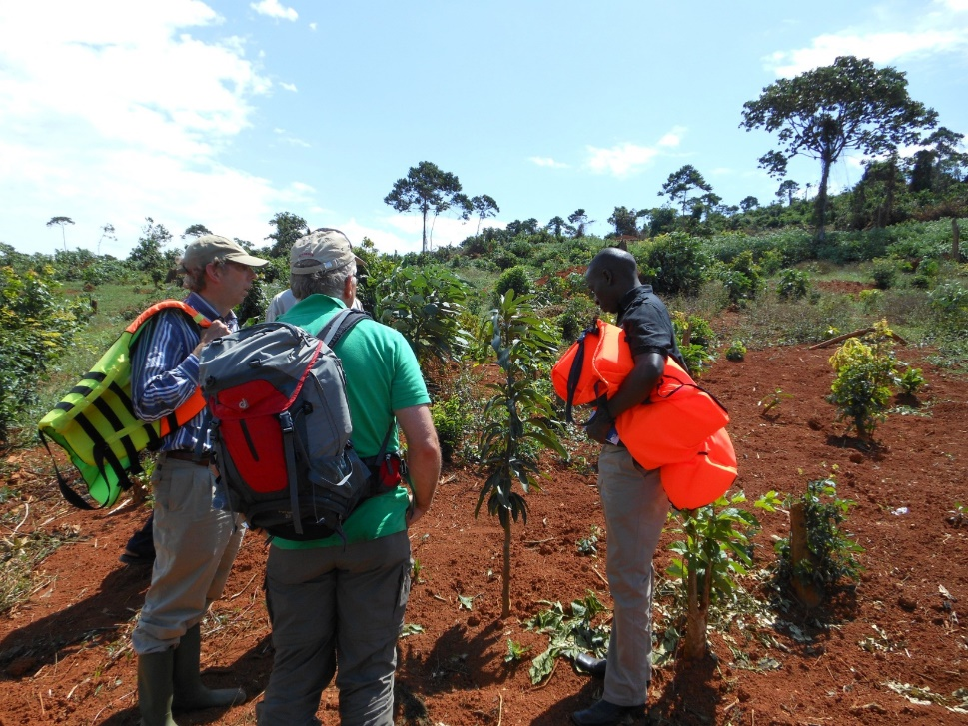
Case: country selected Kenya

Slide 31
How to select a partner company
Criteria | R&S Ltd | Viva Ltd | Lumy-comp Design Ltd | Electro Max SRL | CML | Elba S.A | MK Illumi-nation | Pol-amp | Lumen-max | Inven-tronics
Product quality | 3 | 3 | 5 | 4 | 3 | 4 | 5 | 4 | 4 | 4
Environmental Awareness | 3 | 1 | N/A | N/A | N/A | 5 | 5 | N/A | 3 | 5
Price | N/A | N/A | N/A | N/A | N/A | N/A | N/A | N/A | N/A | N/A
Time delivery/Lead Time | N/A | N/A | N/A | N/A | N/A | N/A | 5 | 3 | N/A | 4
Certification | 5 | 3 | N/A | 3 | 4 | 5 | 3 | 4 | 4 | 5
Experience with the affiliates | 2 | 4 | 4 | 3 | 4 | N/A | N/A | 3 | 3 | 3
Contact details | 1 | 3 | 4 | 3 | 3 | 4 | 5 | 3 | 3 | 3
LPI | 3 | 3 | 3 | 4 | 4 | 4 | 4 | 5 | 5 | 5
Ease of doing business indicator | 4 | 4 | 4 | 3 | 3 | 3 | 3 | 5 | 5 | 5
Total Score | 21 | 22 | 20 | 20 | 21 | 25 | 30 | 27 | 27 | 25
Rank | 7-8 | 6 | 9-10 | 9-10 | 7-8 | 4-5 | 1 | 2-3 | 2-3 | 4-5
Selection of partner company/ companies in the target market.
Vendor rating model

Slide 32
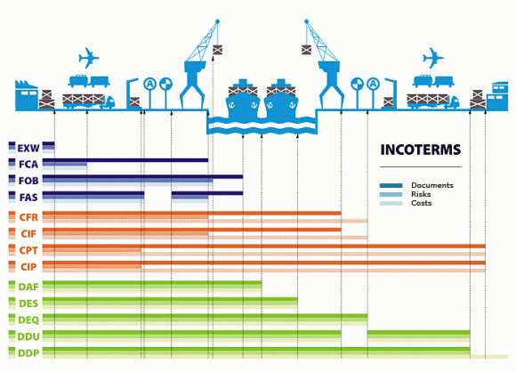
How to manage risks?
Some measures:
- Payment in advance (Internet shopping)
Bank guaranty
Credit insurances
- Be careful about INCO terms and responsibilities

Slide 33
INCO terms

